Slide 1

Cloud Computing and Game Server
Game Server Programming

Slide 2

Contents
Source: code.presso
The era of renting computing resources has arrived
Introduction to cloud computing
Four main characteristics of cloud computing
Types of cloud computing
Key terms of cloud computing
Major domestic and foreign cloud service providers
Game servers and cloud computing

Slide 3

1. The era of renting computing resources has arrived

Slide 4
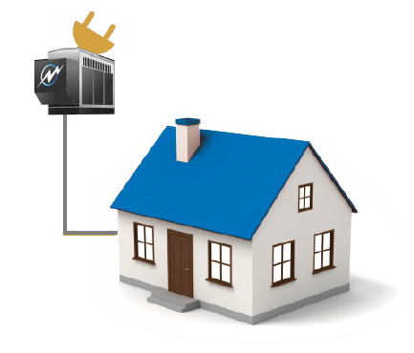
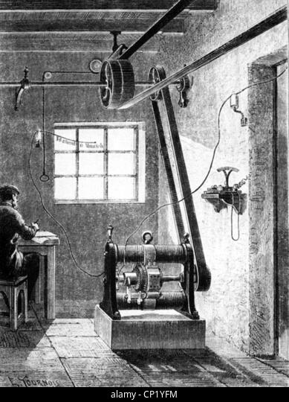
Electricity usage
Generator Installation
High initial setup costs
Limited capacity
A lot of effort
Whenever you need it
Pay only for what you use
Flexible capacity
Less effort

Slide 5
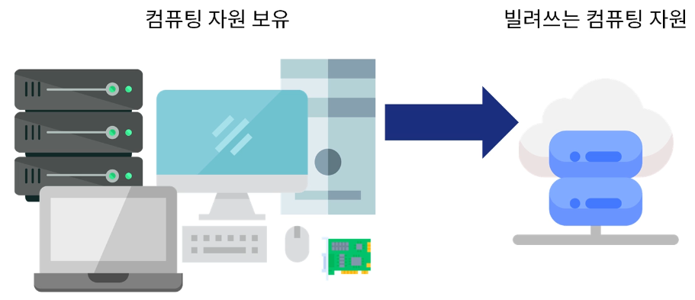

Now, we also rent computing resources!
Owning computing resources
Borrowing computing resources

Slide 6

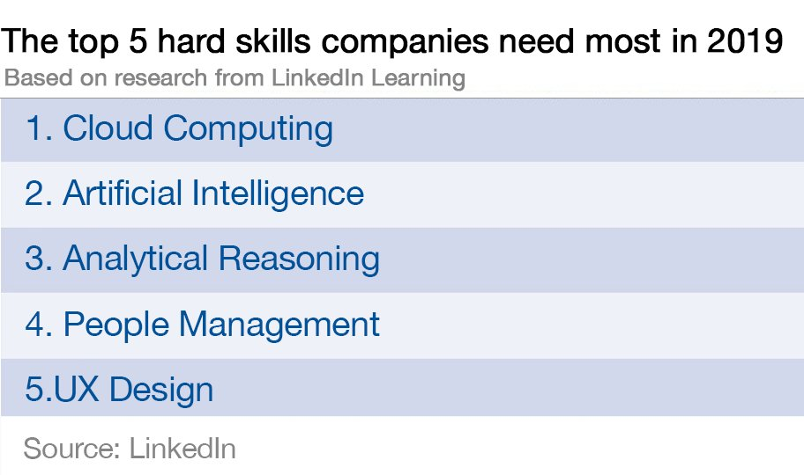
Cloud is the technology that businesses need most…

Slide 7
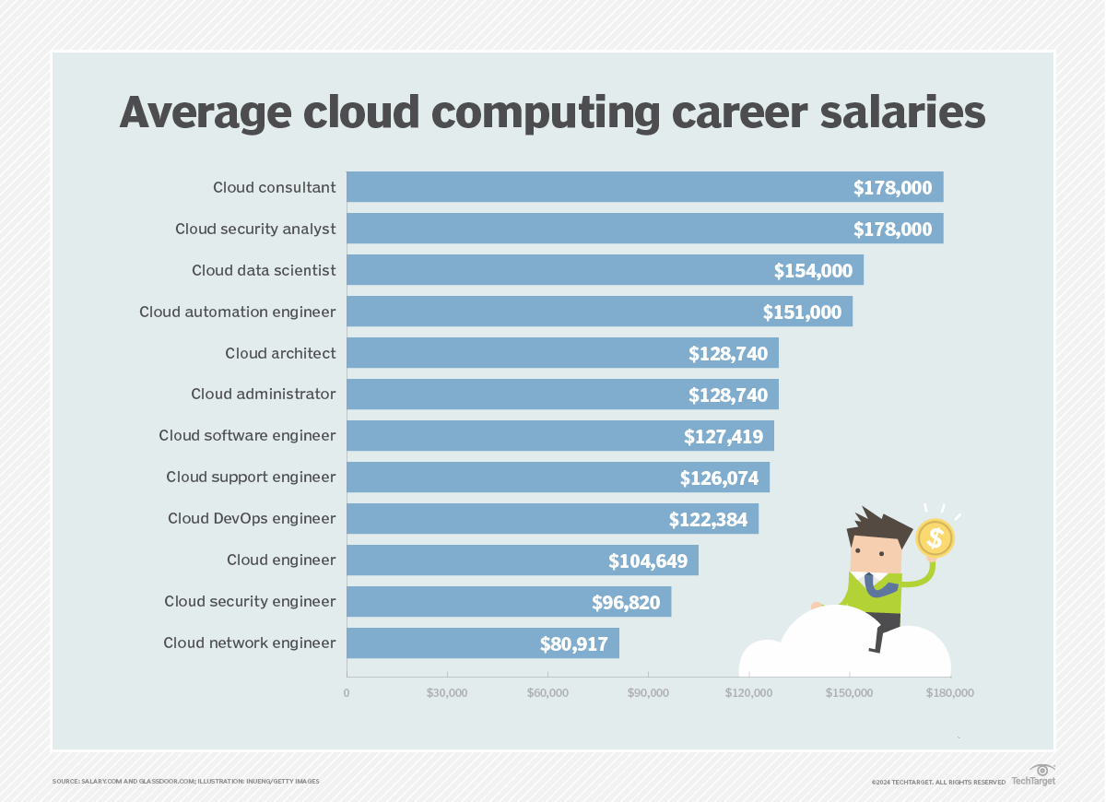

Slide 8
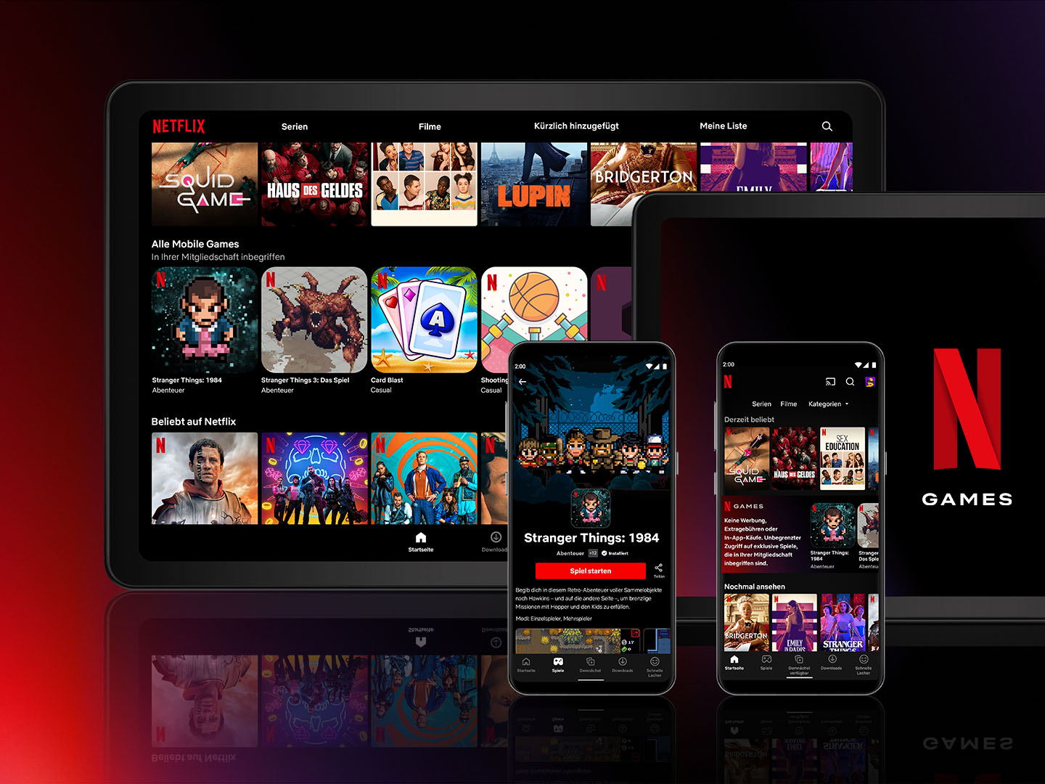
Netflix, loved by all

Slide 9

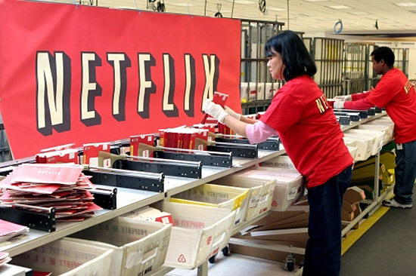
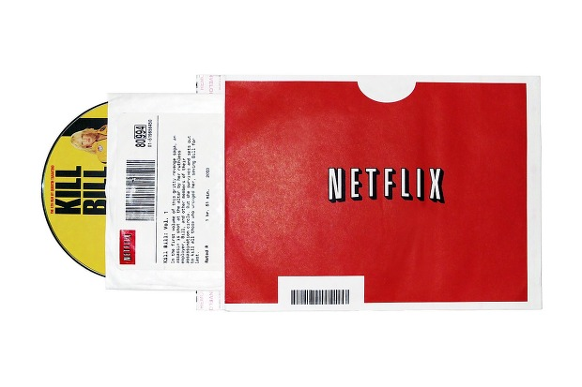
Netflix's Early Business Model

Slide 10
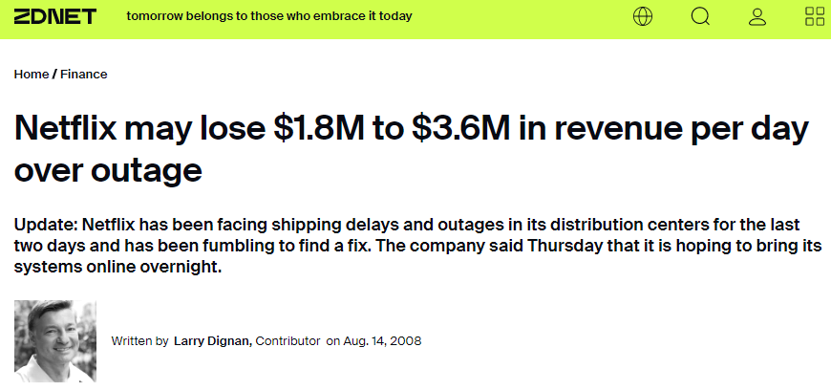
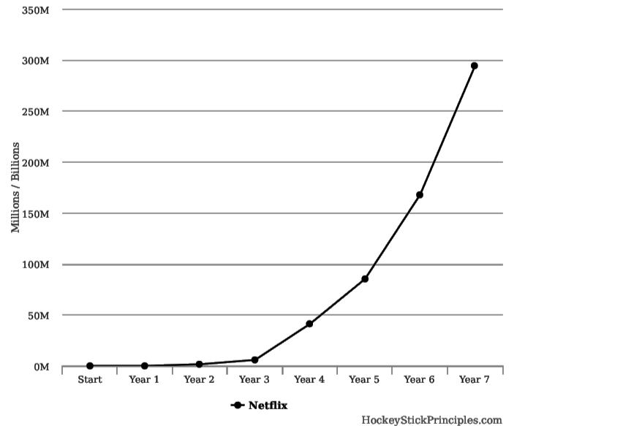
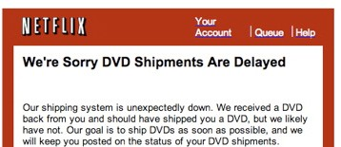
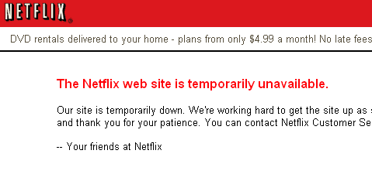
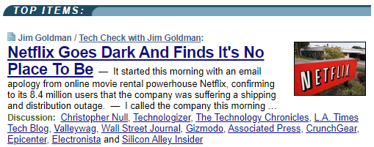
3 days of disruption during rapid growth !!!

Slide 11
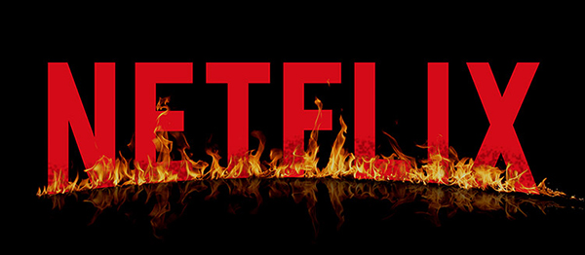

What's Netflix's choice?...

Slide 12
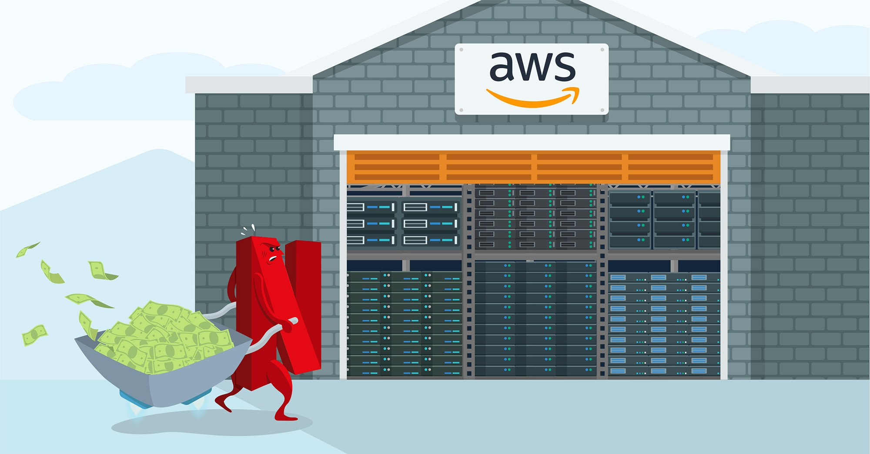
Moving Netflix’s Systems to AWS

Slide 13
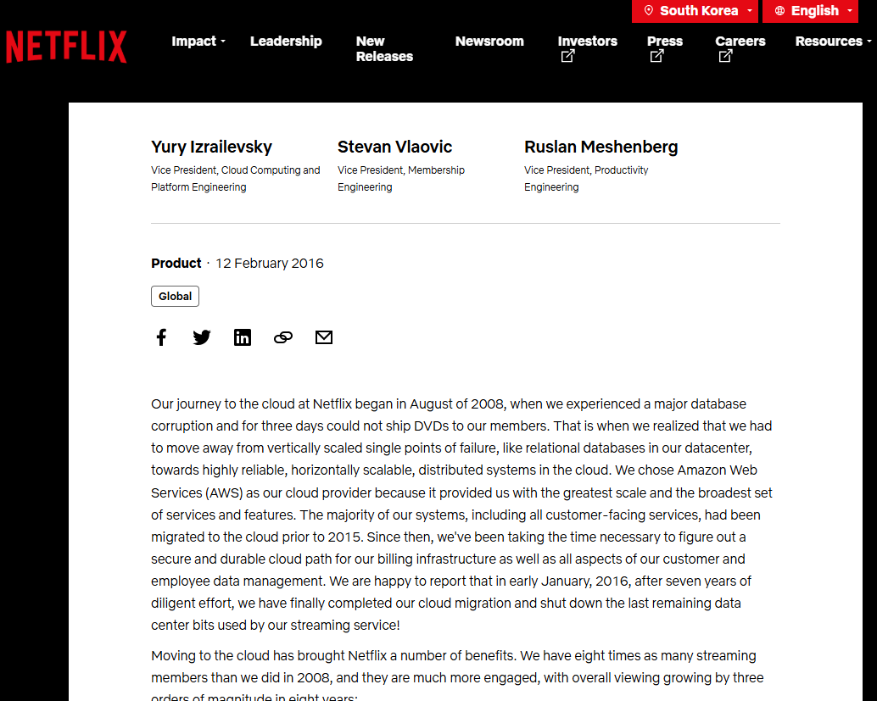
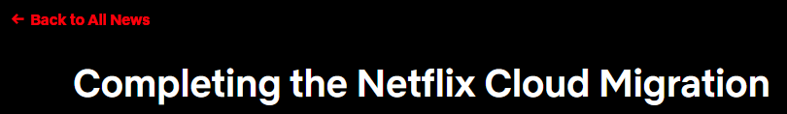
Cloud migration complete after 8 years of work
https://about.netflix.com/en/news/completing-the-netflix-cloud-migration

Slide 14
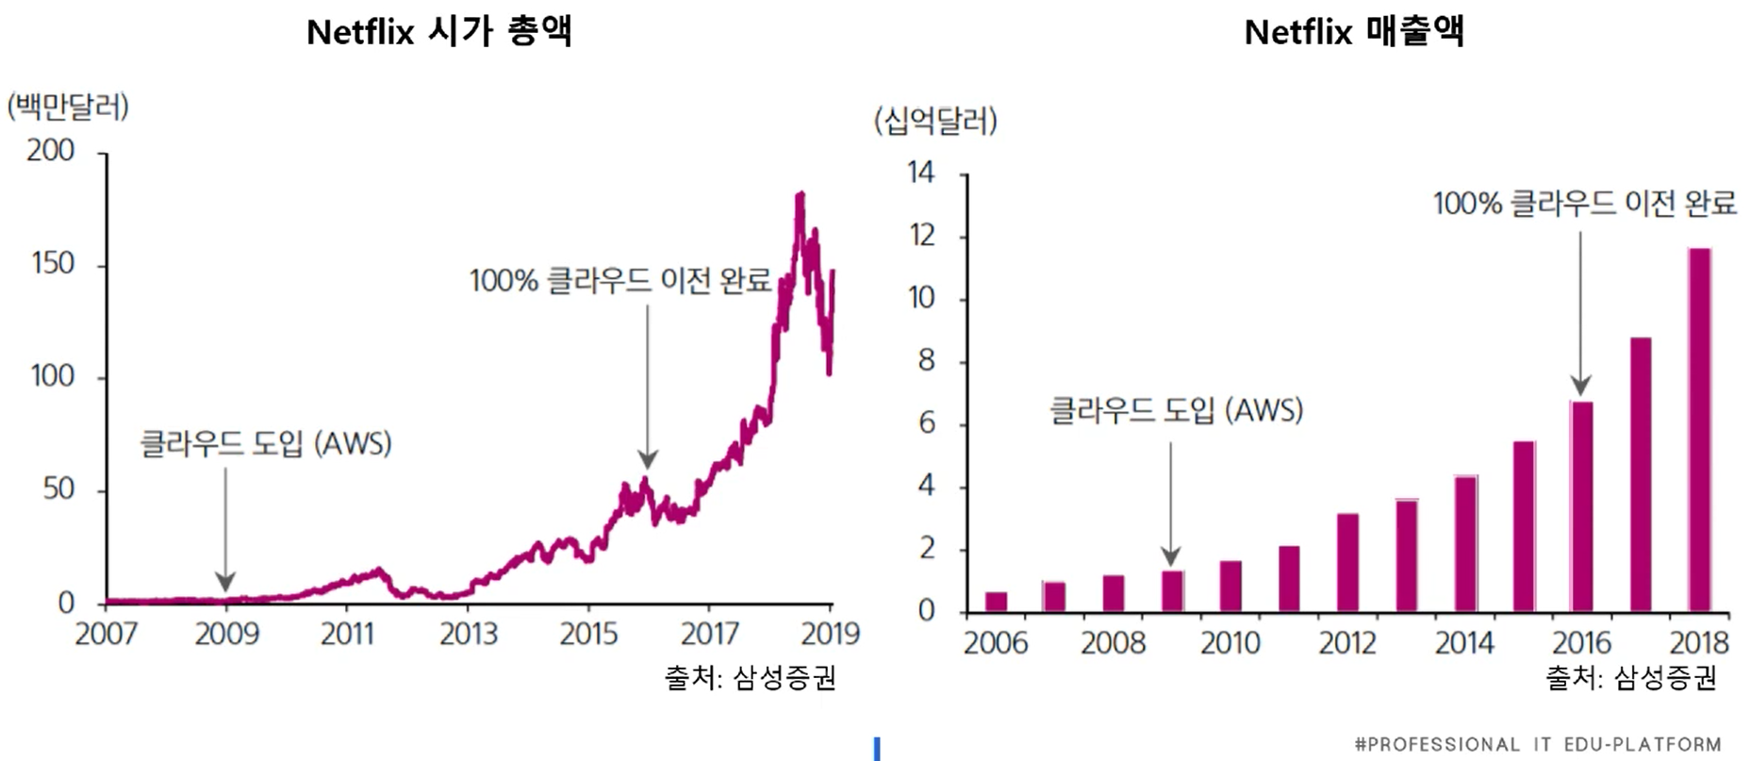
What are the results of cloud adoption?
Netflix Market capitalization
Netflix Sales
(Million Dollars)
(Billion Dollars)
Cloud Migration Completed
Cloud Migration Completed
Cloud Adoption (AWS)
Cloud Adoption (AWS)

Slide 15

Traditional IT Resource Management
Capacity Estimation
Purchasing Server
IDC Warehousing
Connecting Network
OS Installation
SW Installation
Operation Management
Real-Time Monitoring

Slide 16


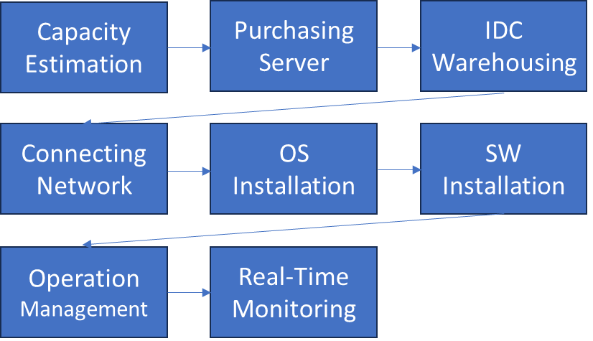
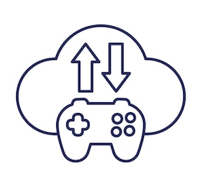
When you adopt the cloud…

Slide 17
Cloud is one of the reasons for Netflix's success…
Leave IT resource management to AWS, Netflix focuses on content
Background that enabled rapid global expansion
By using the cloud, companies can focus on their core business

Slide 18



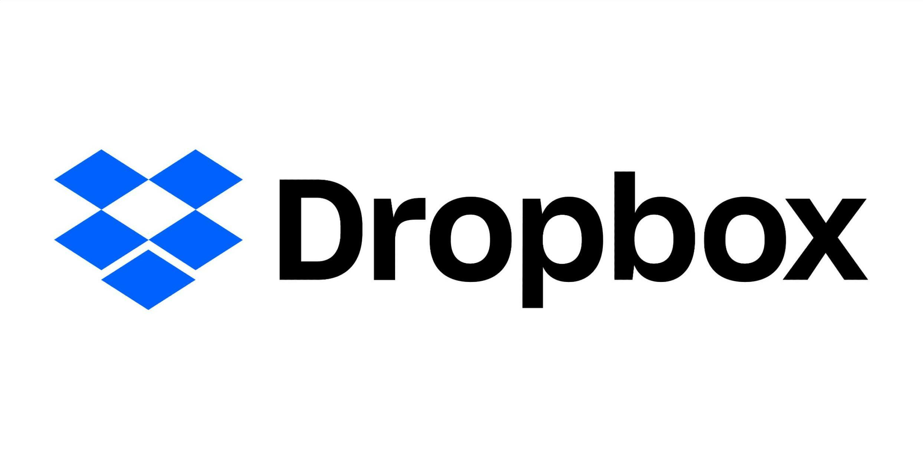
Many of AWS's early customers have grown into global companies.

Slide 19
Summary: The era of renting computing resources has arrived.
Cloud Computing is one of the hottest technologies right now… ICBM, ABCD
The introduction of the Cloud allows companies to focus on the essence of their business
Companies introduce the Cloud to maximize management efficiency
Therefore, if cloud computing technology is introduced to game servers, various positive factors, such as flexible scalability, can be considered.

Slide 20

2. A formal Introduction to Cloud Computing

Slide 21
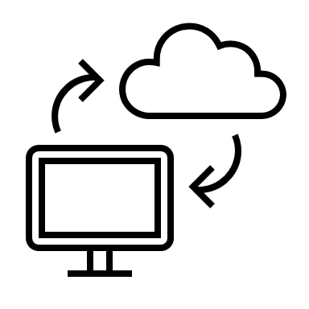
Cloud Computing is…
Providing IT resources of virtualized computers through the Internet.
A type of Internet-based computing that refers to the technology of processing information through another computer connected to the Internet rather than one's own computer.

Slide 22
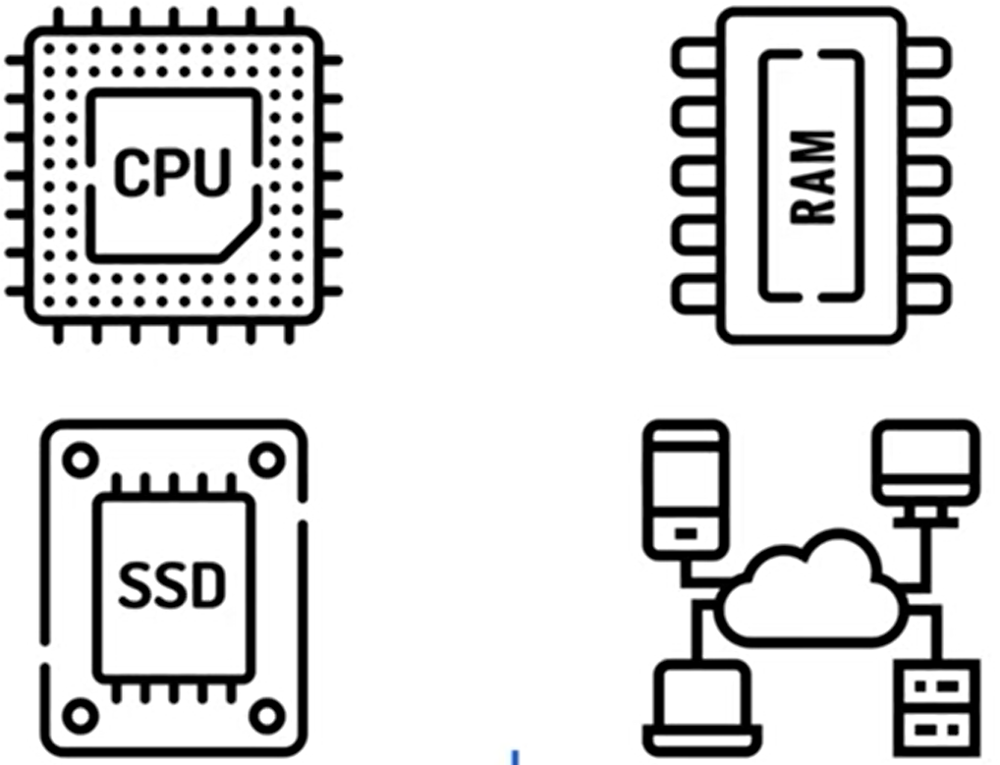
IT resources?

Slide 23
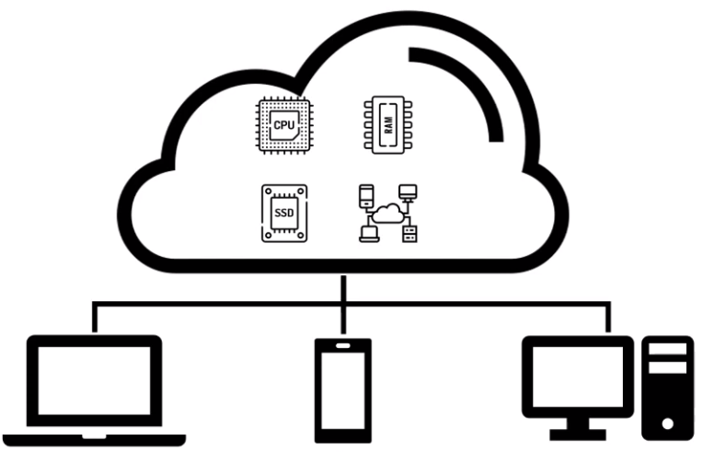
Cloud computing concept

Slide 24
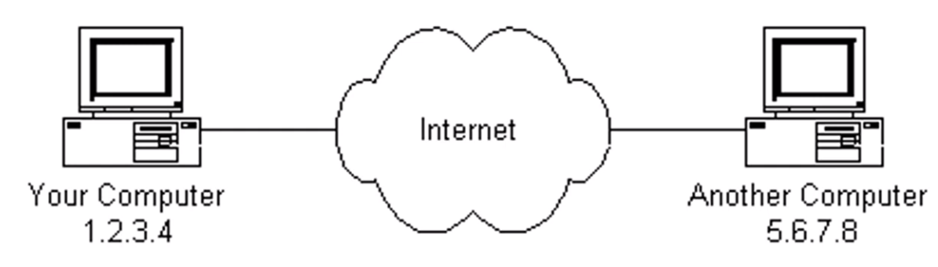
Origins of “Cloud” Terminology
Expressing something that exists but is complex and does not necessarily need to be known by abstracting it into a cloud

Slide 25
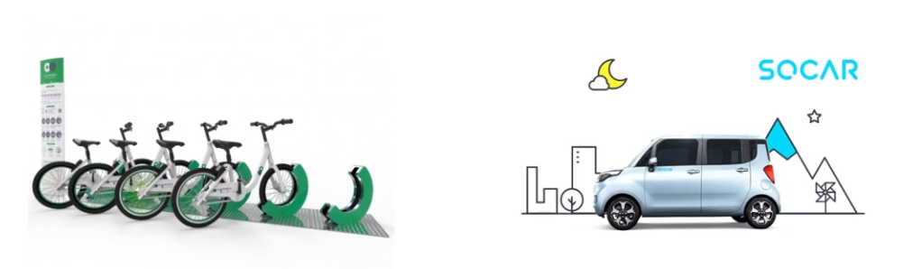
Cloud's biggest feature?
Use computing resources when you want, as much as you want
Pay only for what you use

Slide 26

X As A Service
A form of receiving X as a service and paying a usage fee
Mobility As A Service
Housing As A Service
Video As A Service

Slide 27
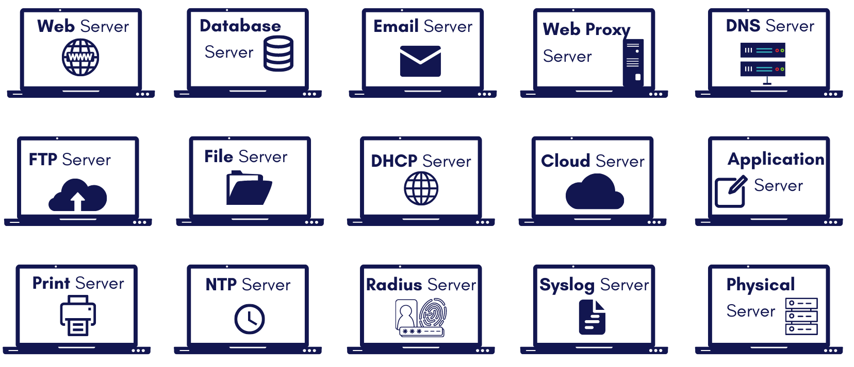
X As A Service
Cloud Computing is
Computing Resource As A Service
IT Resource As A Service

Slide 28
Computing Resource
What are the main Computing Resources?
Why should Computing Resources be provided in the form of a Service?

Slide 29
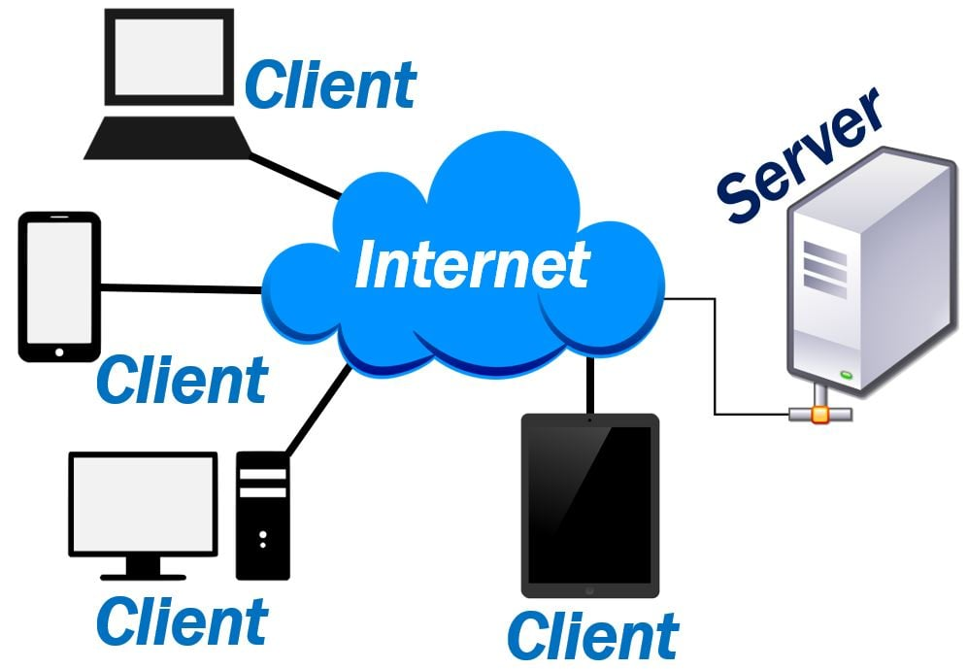
Computing Resource & Server
The Internet world, simply put, is made up of servers and clients.

Slide 30
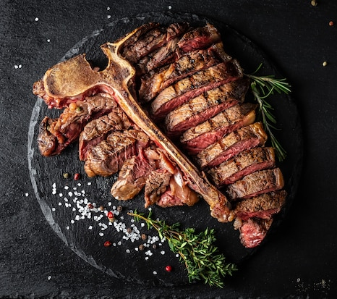
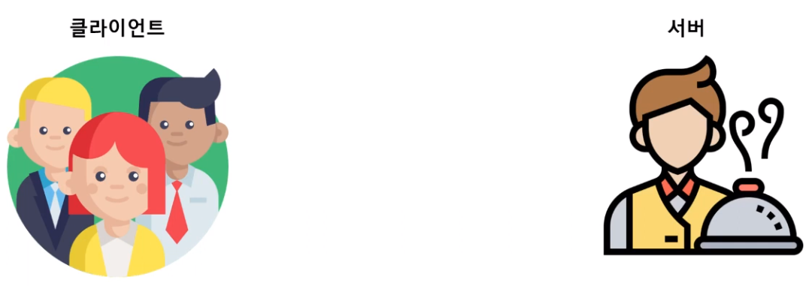
Server at a Restaurant
client
Server
Give me a steak~
Yann
The client makes a request and receives the result of the request.
The server receives the request, processes it appropriately, and responds with the result.

Slide 31
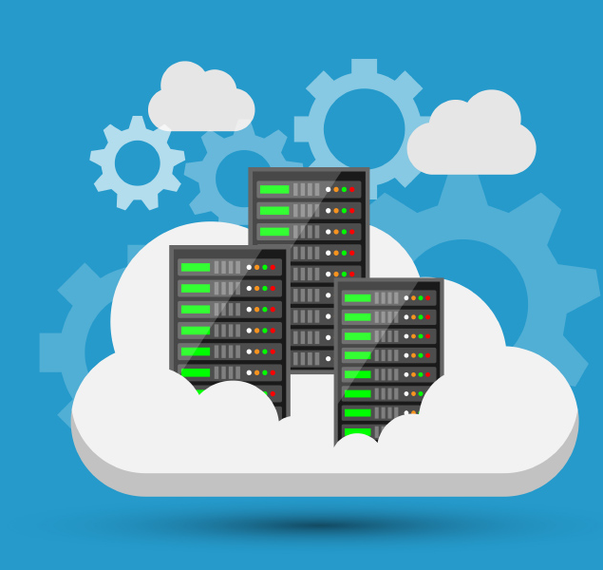
Server in the Internet world
In the Internet world, servers also receive requests, process them, and return results.
In the Internet world, servers are the core computing resource.

Slide 32

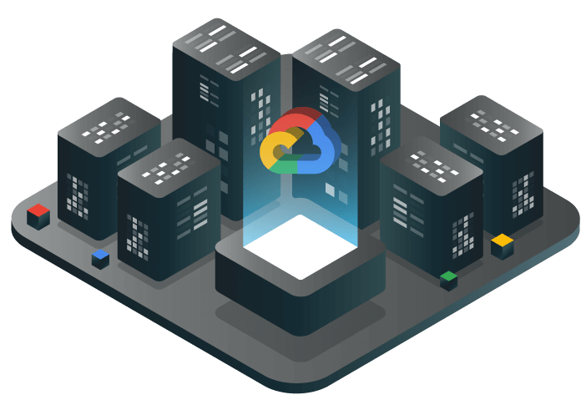
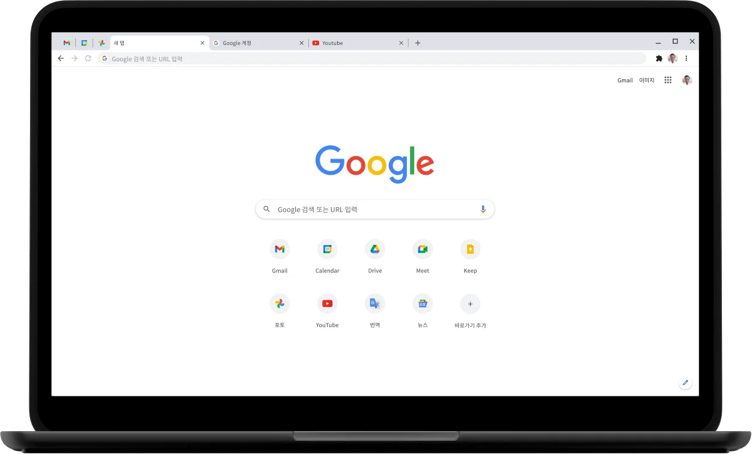

What happens when you access Google from a browser?
Give me Google.com page data
Here goes the data <html><body>…

Slide 33



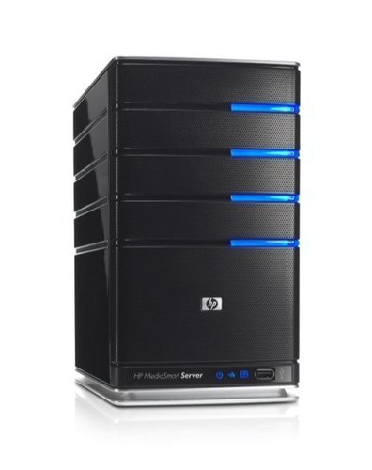
What happens if you ‘Like’ on Instagram?

Slide 34
The problem is that it requires a lot of servers!

Slide 35
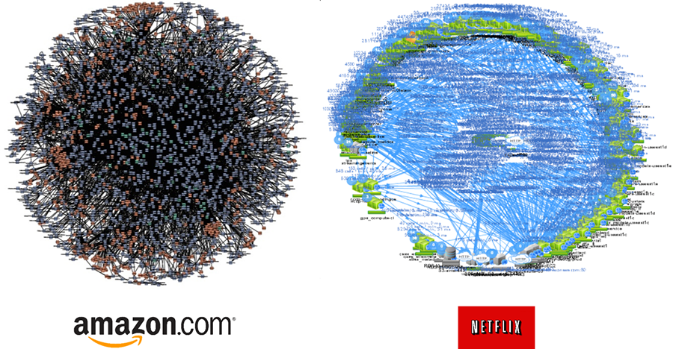
The more customers you have, the more you need~~

Slide 36

Let's take a kimchi fried rice restaurant as an example.
Tom opened a kimchi fried rice restaurant.
Tom prepared the ingredients expecting about 30 customers a day, and actor Tom Cruise came and had the kimchi fried rice deliciously~ :0

Slide 37


The next week… Tom prepared for many customers… expected…
Prepare 300 servings of Kimchi Fried Rice!
FoodX Broadcast reports on the hygiene issues of foreign kimchi used in kimchi fried rice!

Slide 38
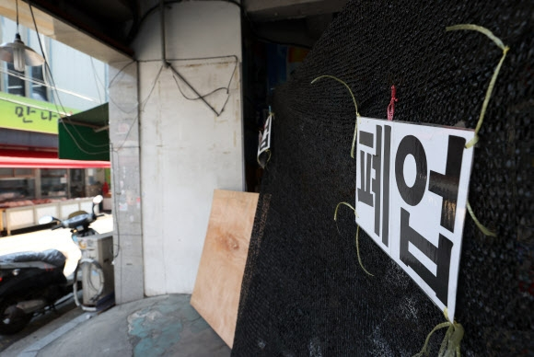


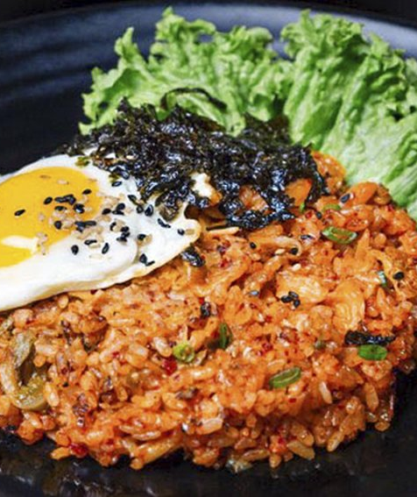
In the end, the business failed ㅠ.ㅠ

Slide 39
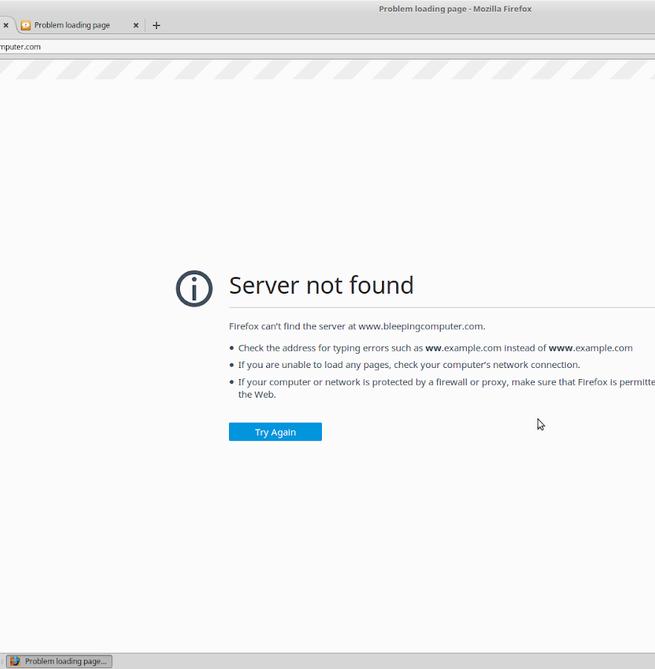
This also happens frequently in the Internet industry.
BTS Concert Reservation
Class Registration Period
Popular Short-Term Event Reservation

Slide 40
What is the cause?
This occurs because the amount of server resources I prepared and the actual usage do not match.

Slide 41
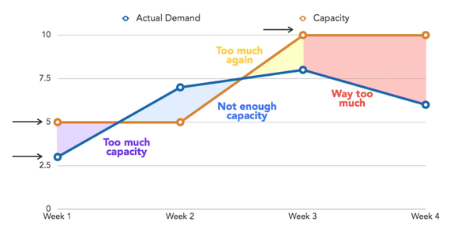
Discrepancy between prepared amount and actual usage

Slide 42
Again… back to the kimchi fried rice restaurant example
What if there is a market selling ingredients related to kimchi fried rice next to a kimchi fried rice restaurant?
Ability to respond flexibly to demand
Ability to flexibly deal with problems such as a shortage or overabundance of kimchi fried rice!

Slide 43
When we introduce Cloud Computing
Flexible response to computing resources
When traffic is high, we can immediately rent the servers and bandwidth we need
When traffic is low, we can immediately return the servers we don't need anymore!

Slide 44
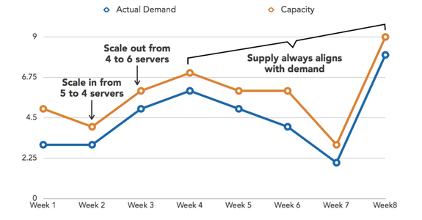
Resources can be used flexibly according to demand

Slide 45
Summary: Introduction to Cloud Computing
Cloud Computing is the processing of tasks using other computing resources connected to the Internet
Cloud Computing is the concept of Computing Resource As A Service
Cloud computing enables resources to be used flexibly according to demand

Slide 46

3. Major Features of Cloud Computing

Slide 47
Features of Cloud Computing
On Demand
Massive Scalability
Pay-as-
you-go
Easy management

Slide 48

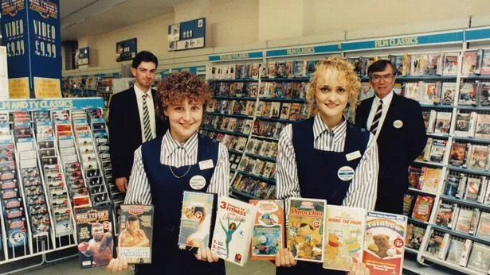
Feature 1: On Demand
Once upon a time, if you wanted to drink water and watch a movie…
Go to the well and get water.
Go to the video rental store and rent a video tape.

Slide 49

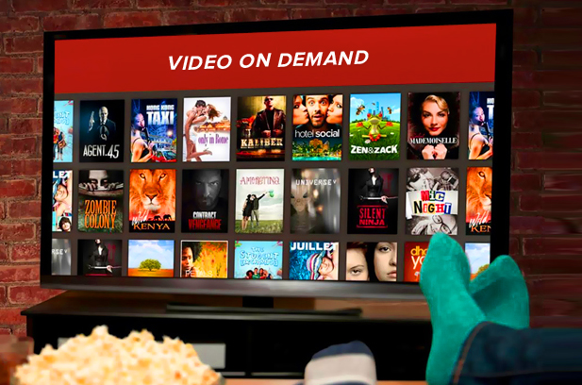
Feature 1: On Demand
Water on Demand
Video on Demand

Slide 50
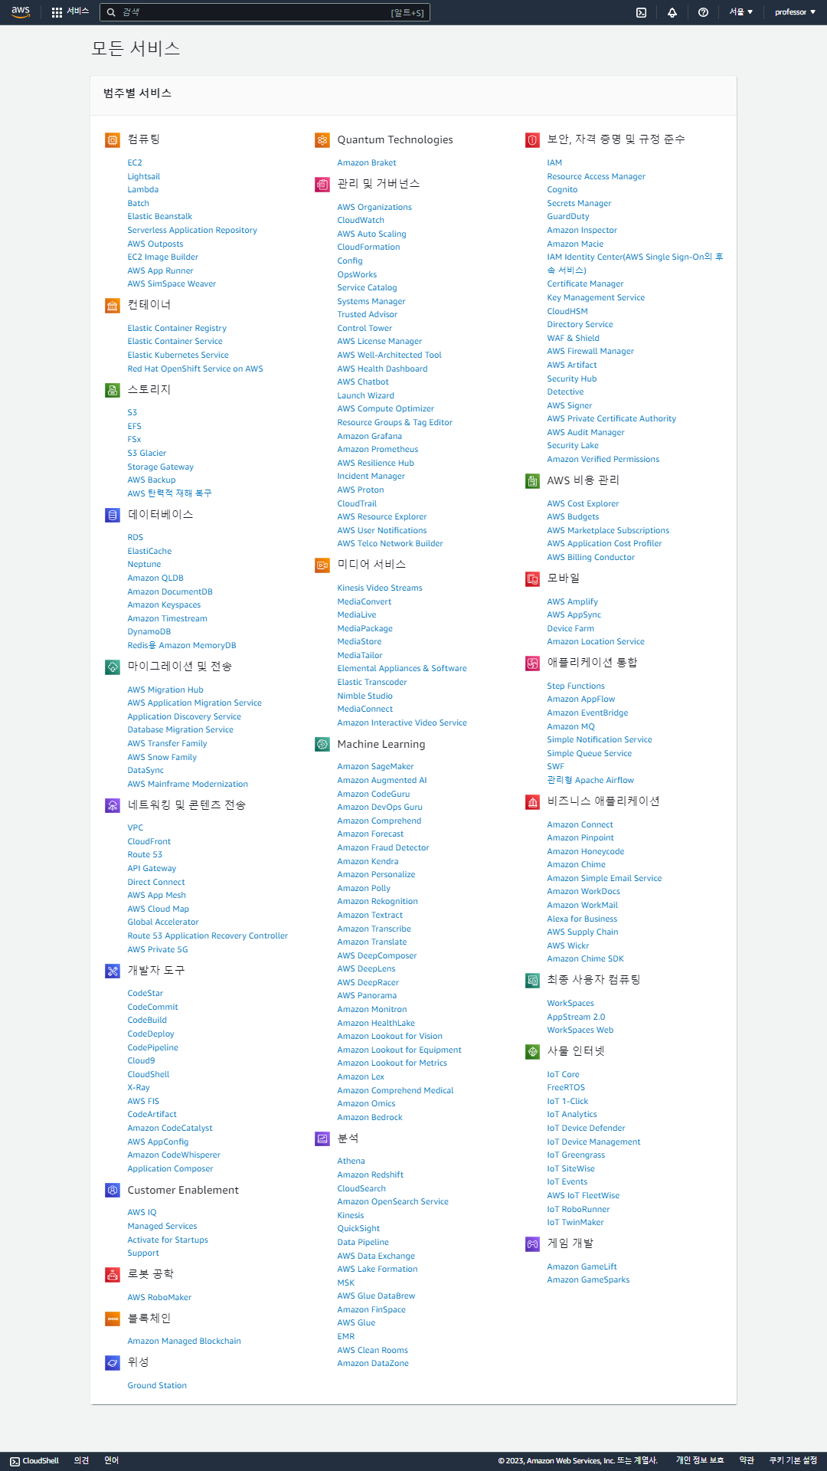
Feature 1: On Demand
Various IT resources provided by AWS
Computing Resource on Demand
We can borrow computing resources whenever we want.

Slide 51
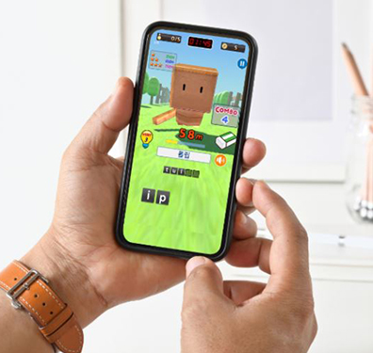
Feature 2: Massive scalability
Started a business and developed a game
Usually operates with about 100 daily users and 2 servers
The game was introduced in the media as good for improving IQ, so traffic increased 1000 times

Slide 52

Feature 2: Massive scalability
Is it possible to increase the server count by 1,000 by tomorrow?
Impossible → Customers won't wait → Business failure

Slide 53
Feature 2: Massive scalability
With the cloud,
Prepare 1,000 servers in 10 minutes
Prepare 10,000 servers in 10 minutes
Large-scale expansion according to demand is possible within minutes!!!

Slide 54
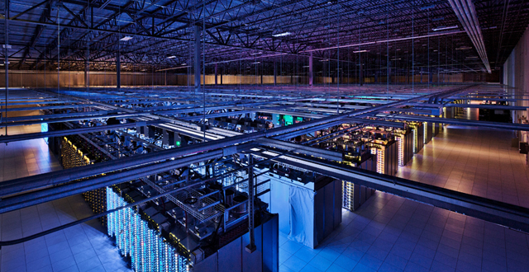
Feature 2: Massive scalability
Cloud service providers build large-scale computing resources in advance.

Slide 55
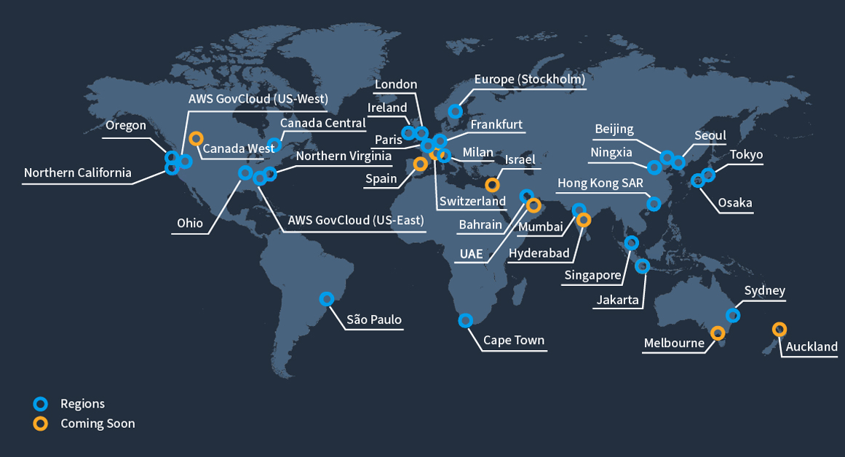
Feature 2: Massive scalability
AWS builds computing resources in major cities around the world.

Slide 56
Feature 3: Pay-as-you-go billing
To start an internet business, you need to buy a server, operate the server, network…
All of this is initial cost
What if you invest tens of millions of dollars and the business doesn’t go well or fails?

Slide 57
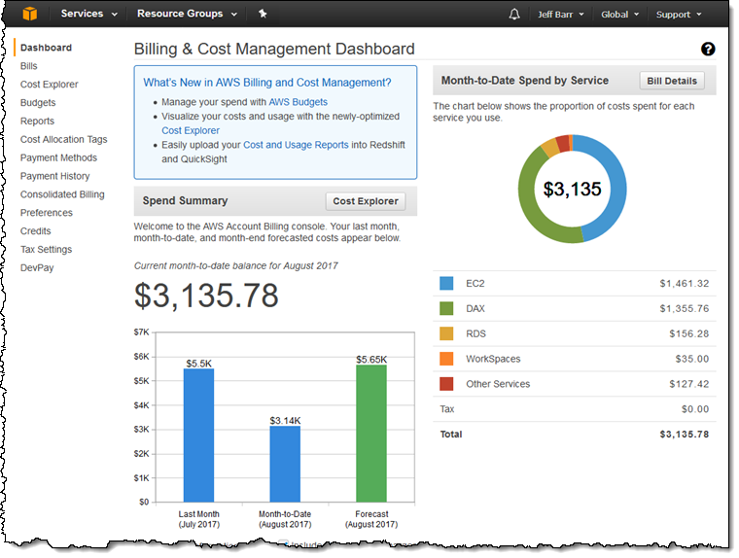
Feature 3: Pay-as-you-go billing
Cloud services allow you to pay only for what you use.
Lower initial costs reduce risk.
Building Page on Amazon Web Services

Slide 58
Feature 4: Convenience of management
Capacity Estimation
Purchasing Server
IDC Warehousing
To purchase and manage a server directly
For traditional IT resource management methods, a specialist is essential
Directly set up and manage servers, networks, security, etc.
Connecting Network
OS Installation
SW Installation
Operation Management
Real-Time Monitoring

Slide 59
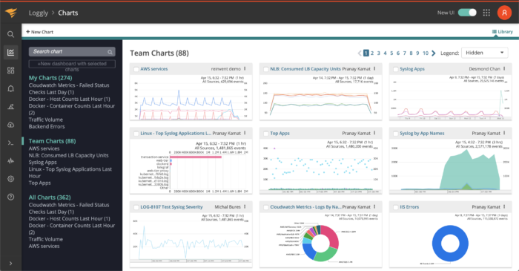
Feature 4: Convenience of management
In the early stages of cloud adoption, more efficient management is possible
Cloud operators provide the functions necessary for IT resource management
Cloud experts are needed for professional operation
This monitoring function allows you to view the current status of the IT resource.

Slide 60
Summary: Cloud Computing Features
Cloud Computing has four main characteristics: On Demand, large-scale scalability, pay-as-you-go billing, and management convenience.
On Demand and large-scale scalability are the characteristics of enabling large-scale expansion of IT resources at any desired time.
Pay-as-you-go billing is the characteristic of paying only for what you use.
Management convenience is the characteristic of easy initial management as cloud service providers provide IT resource management functions.

Slide 61

4. Types of Cloud Computing

Slide 62
Cloud Computing Classification Criteria
Service Model
IaaS^{Infrastructure as a Service}
PaaS^{Platform as a Service}
SaaS^{Software as a Service}
On Premise
Deployment Model
Public Cloud
Private Cloud
Hybrid Cloud

Slide 63
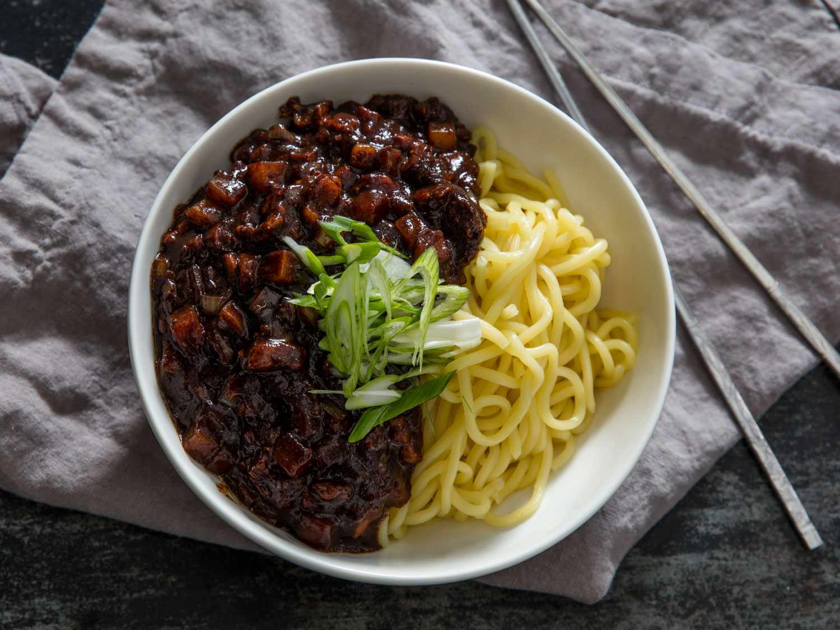
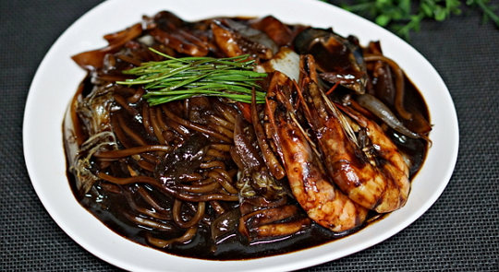
Jjajangmyeon^{Noodles with blackbean sauce}
Jajangmyeon (Korean: 자장면) or jjajangmyeon (짜장면) is a Korean Chinese noodle dish topped with a thick sauce made of chunjang, diced pork, and vegetables.

Slide 64




Let’s say you like to cook and eat Jjajangmyeon…
On Premise
IaaS
Infra as a Service
PaaS
Platform as a Service
SaaS
SW as a Service

Slide 65
Cloud Computing Service Models
On Premise
IaaS
PaaS
SaaS
Tableware setting
Tableware setting
Tableware setting
Tableware setting
Cooking
Cooking
Cooking
Cooking
Jjajang source
Jjajang source
Jjajang source
Jjajang source
Vegetables
Vegetables
Vegetables
Vegetables
Noodles
Noodles
Noodles
Noodles
Frying pan
Frying pan
Frying pan
Frying pan
Gas ranges
Gas ranges
Gas ranges
Gas ranges

Slide 66

Cloud Computing Service Models

Slide 67
IaaS ^{Infrastruture as a Service}
Provides only basic IT resources
Server, Storage, Network
Concept of purchasing a new computer

Slide 68
PaaS ^{Platform as a Service}
Add OS, Middleware, Runtime to IaaS
middleware: DB access, RPC
Runtime: JDK, Python, etc. The environment where the program runs
The scope of the concept is the broadest
Generally targeted at developers
A state where you can upload just by developing code
AWS Elastic Beanstalk, Google App Engine, Goorm IDE

Slide 69
SaaS ^{Software as a Service}
SaaS – Software as a Servicde
Provides SW with all functions
Naver Cloud
Google Drive
Google Calendar
Naver Mail
Office 365
Dropbox
…

Slide 70
Cloud Computing Service Models
IaaS: Provides computers
PaaS: Provides an environment where services are provided by simply developing and distributing code
SaaS: Provides everything by paying money
SECaaS^{Security as a Service}
NaaS^{Network as a Service}
BaaS^{Backend as a Service}
FaaS^{Function as a Service}
Serverless

Slide 71
Deployment Model
View on how the Cloud is actually built
Public Cloud
Private Cloud
Hybrid Cloud
Community Cloud

Slide 72

Deployment Model

Slide 73
Public Cloud
Anyone who needs cloud services can use it
Only pay for what we used
Cloud service providers provide IT resources as a service

Slide 74
Private Cloud
Build a Cloud Computing environment that can only be used within a company or organization
People who are not part of the company/organization cannot use it
Building Private Cloud is difficult, but it can be used for reasons such as security/legal regulations

Slide 75
Hybrid Cloud
A form that combines public and private clouds
Systems that require security can use private clouds, and other systems can use public clouds
Private clouds are mainly used, but when unexpected traffic levels are high, they can be expanded to public clouds
There are various scenarios, and this is the form that companies are most interested in recently

Slide 76
Summary: Types of Cloud Computing
The classification criteria for Cloud Computing are Service Model and Deployment Model
Service Model is classified into IaaS, PaaS, and SaaS
Deployment Model is classified into Public, Private, and Hybrid Cloud

Slide 77

5. Cloud Terminology

Slide 78
Cloud Key Terms
Data Center
Region
Availability Zone
Virtualization

Slide 79


Data Center
A facility that gathers numerous servers and connects them to a network.
IDC^{Internet Data Center}
CDC^{Cloud Data Center}
Server Hotel

Slide 80


Data Center
Data Center is the foundation of the Cloud
As the Cloud industry grows, more and more Data Centers are being built.
Rack
A frame that houses servers or network equipment
Rack-mounted servers – the layers within a rack are one server
Rack-mounted servers allow for efficient use of space

Slide 81


Data Center
An important management point in data centers is heat management
Facebook built a data center in Sweden, a cold climate
Naver uses technology called NAMU to lower the temperature by flowing cold water through a wall and allowing wind to pass through it through evaporation
Naver DATA CENTER GAK @ ChoonChun

Slide 82

MS Underwater data center
https://www.youtube.com/watch?v=d3BYVaIAewE

Slide 83

Region ^{aws}
Regoin is the area where the Data Center is located.
It usually refers to a city.

Slide 84

Region ^{google}

Slide 85

Region ^{naver}

Slide 86

Region
You can select the region where you want to create IT resources
You can create resources in data centers around the world, even in Korea

Slide 87

Region
Region selection has a significant impact on service performance.
The region where the target customer's region and the region where the resource will be created should be as close as possible.

Slide 88
Region
To provide services to Korean customers, create resources in the Seoul Region.
To provide services to US customers, create resources in the US West/East Region.
When selecting a cloud service provider, check if the service target country can select a region.

Slide 89
Region
Resource usage costs vary by region.
Land, taxes, etc. vary by country.

Slide 90

Availability Zone
A Region consists of two or more Availability Zones
Availability Zone is abbreviated as AZ
One AZ is one Data Center

Slide 91
Availability Zone
Availability: The state in which the system operates normally
If the service is operated only in a single Data Center (AZ),
The Data Center (AZ) may be subject to failure due to earthquake, lightning, power outage, etc.
The service is not accessible until the Data Center (AZ) is restored
Low Availability

Slide 92
Availability Zone
If you operate the service by distributing it to multiple Data Centers (AZ),
even if a problem occurs in a specific Data Center, you can access other Data Centers
High Availability

Slide 93

Availability Zone
AZ is a device to increase availability for failures
Distribute services to multiple AZs within a region to satisfy high availability

Slide 94

Virtualization
Virtualization is a technology that creates virtual hardware using software
Virtual hardware is VM – Virtual Machine
When using a server in a cloud service, you are usually provided with a virtualized server rather than a single physical server.

Slide 95


Virtualization

Slide 96
Virtualization advantages
If one person lives alone in a 200m² apartment, it is inefficient.
Renting 4 rooms to other people -> Living together is inconvenient.
Building a partition wall in a 200m² apartment to make it look like 4 houses, so 4 people can live together.
Increased efficiency, no interference with each other.

Slide 97


Virtualization advantages

Slide 98
Summary: Cloud Computing Key Terms
Data Center is a facility that provides servers and network resources, etc.
Region is a country/city where a Data Center is built
Availability Zone is a distributed Data Center within a Region for high availability
Virtualization is a technology that creates a virtual machine using SW technology

Slide 99
6. Major domestic and foreign cloud service providers
Amazon Web Service
MS Azure
Google Cloud Platform
IBM Bluemix
Naver Cloud Platform
Samsung SDS
NHN Entertainment Toast Cloud
SK Cloud Z
KT Cloud
Alibaba Cloud
Tencent Cloud

Slide 100

Global Market Shares

Slide 101

AWS^{Amazon Web Services}
The top player in the cloud market
First service opened in 2006
22 regions and 69 AZs
3 AZs in Seoul Region
Total 212 services provided

Slide 102

MS Azure
Cloud service launched by Microsoft
2nd place in global market share
Two data centers in Korea: Seoul Metropolitan Area and Busan
Focusing on PaaS services and DevOps services

Slide 103

GCP ^{Google Cloud Platform}
Google's cloud service
Google's operational know-how is integrated
Strength in services related to big data and artificial intelligence
Big data analysis
Machine learning, deep learning services
Launched in Seoul Region in February 2020

Slide 104


Naver Cloud Platform
Cloud service launched by Naver
Global operation know-how of Naver/Line
Overseas Region
Provides the most functions among domestic services
Many AI-related services
https://www.ncloud.com

Slide 105

Toast Cloud
Released by NHN Entertainment
Reflects NHN's game operation know-how
Many game-related services
gamebase, Leaderboard, Launching, Smart Downloader
Provides collaborative service called Dooray
https://www.toast.com/

Slide 106



Alibaba/Tencent Cloud
Cloud services launched by Chinese companies Alibaba and Tencent
China has different traffic scales for even small services
Tencent Cloud has Korea data centers
Game companies entering China use Tencent Cloud

Slide 107
Summary: Major domestic and foreign cloud service providers
There are many cloud services around the world
AWS and Azure are the two major players in the cloud market
AWS has an overwhelming market share in the Korean IaaS market
Korean cloud services are also continuously investing and improving their services

Slide 108

7. Game Servers @ Cloud Computing

Slide 109

The role of the game server
Game servers are responsible for the core functions of a multiplayer game.
State management: Tracks player locations, status, actions, etc.
Synchronization: Ensures that all clients maintain the same game state
Security: Prevents cheating and protects game data

Slide 110

Background on the introduction of cloud computing
Game servers require high availability, scalability, and flexibility.
Cloud computing meets these needs, specifically solving the following problems:
Limitations of traditional servers: Physical servers have significant limitations in scalability and maintenance.
Traffic volatility: Traffic surges during game launches and events.

Slide 111

Benefits of Cloud Computing for Game Server
Scalability
Game servers dynamically allocate resources as the number of players increases
Cloud providers can increase or decrease servers to meet demand through auto-scaling
Cost efficiency
Pay-as-you-go model
Services can be provided without initial hardware investment
Global accessibility
Cloud provides a low-latency network through data centers around the world
Ping is minimized with servers close to players
Backup and recovery
Game data can be safely backed up with cloud storage
High availability (HA) architecture enables rapid recovery in case of failure

Slide 112




Major cloud services and game servers
AWS (Amazon Web Services)
EC2, GameLift: Dedicated game server hosting and scaling support
Google Cloud Platform (GCP)
Agones: Open source game server orchestration based on Kubernetes.
Microsoft Azure
PlayFab: Provides game server management and player analytics

Slide 113

Use Cases for Cloud-Based Game Servers
MMORPG
Utilize the scalability of the cloud in games with large numbers of concurrent players
Battle Royale
Suitable for short sessions and games with large numbers of players
E-sports
Provide tournament-level low-latency environments by utilizing global data centers

Slide 114

Limitations and Considerations of Cloud-Based Game Servers
Cost Management
Possible increased costs during traffic surges
Need for optimized resource allocation and usage planning
Data Privacy
Need to comply with regional data security regulations
Examples: GDPR, CCPA, etc.
Dependency Issues
Being dependent on a specific cloud provider can lead to vendor lock-in
GDPR (General Data Protection Regulation)
CCPA (California Consumer Privacy Act)

Slide 115


Slide 116

[EoF]

